Slide 1
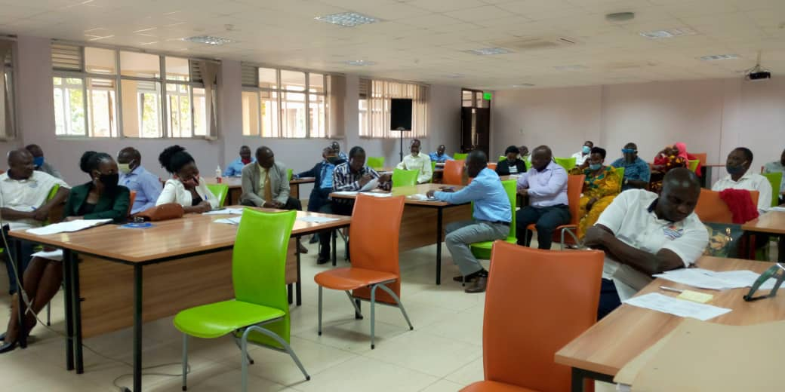
Budget Conference for Jinja District Local Government held at Civil Service College attended by Head of Departments and Head of Sections

