Slide 1
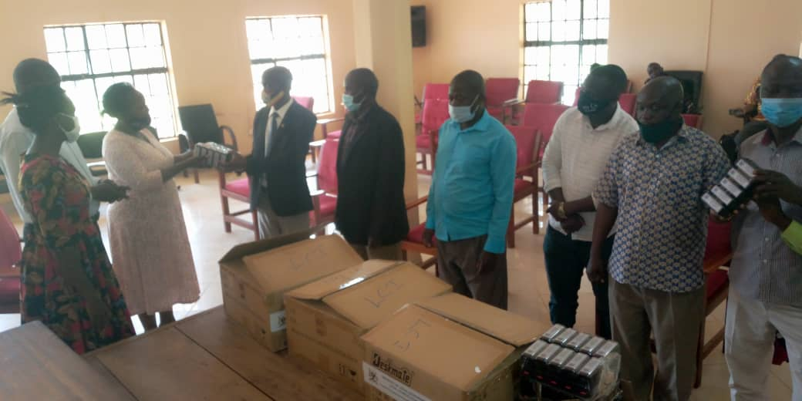
GIVING VILLAGE STAMPS TO LC I AND LC IIs

